Slide 1
Data-driven Fact-checking
Chengkai Li
Associate Professor and Associate Chair
Innovative Database and Information Systems (IDIR) Lab
CSE Department, UT-Arlington
CCC Roundtable
March 26, 2019

Slide 2
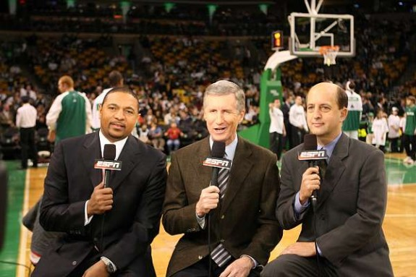

How it Started
2009
Chris Paul had 16 points, 10 rebounds, 13 assists and five steals…… The only other active player to have such a game is Jason Kidd…
How did they come up with that?

Slide 3
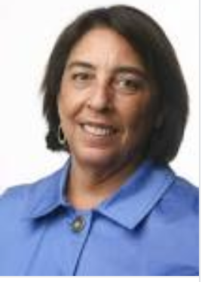
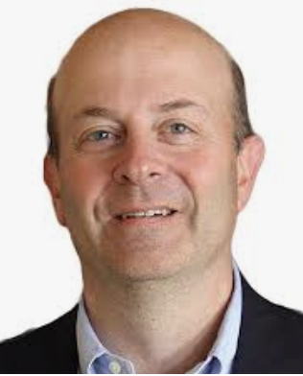
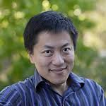
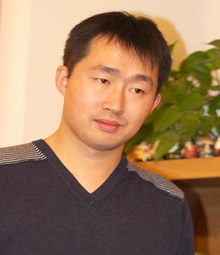
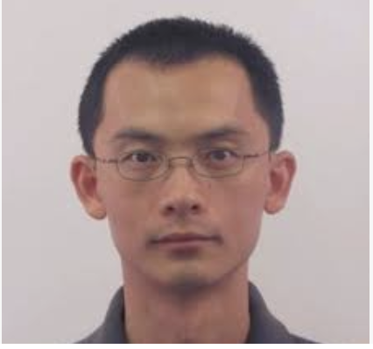
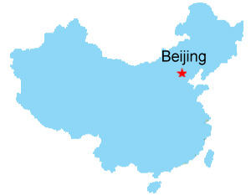

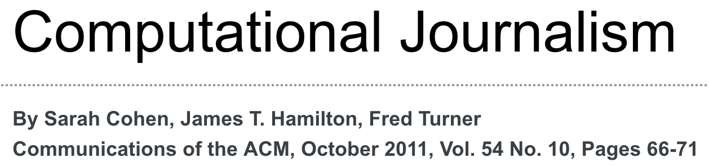
How it Started
“Developing the Field of Computational Journalism” Workshop, July 27-31, 2009
Let’s work on this fact-finding problem.
This is computational journalism.
Summer 2010
#@%&!#!%

Slide 4
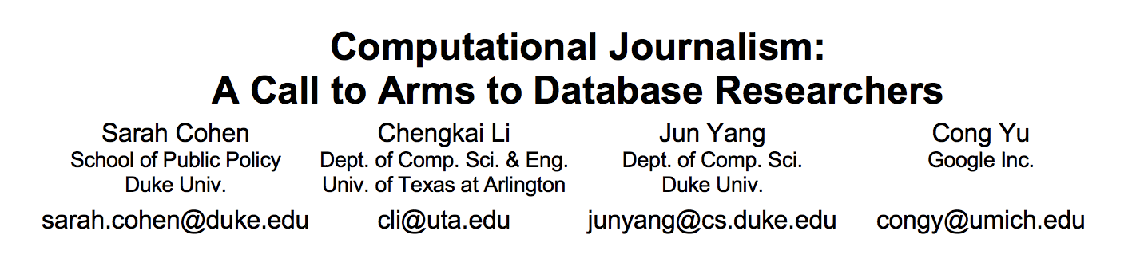
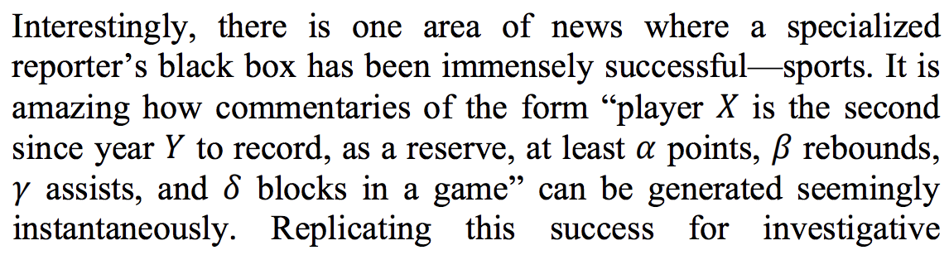
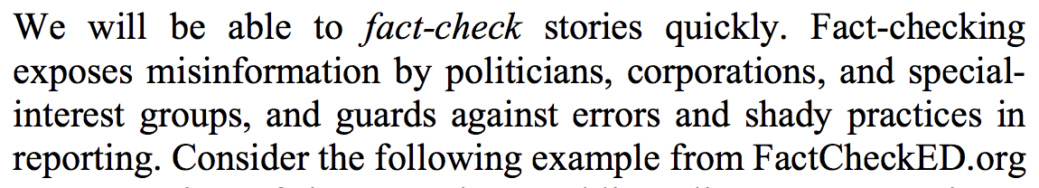
CIDR 2011
fact-finding
fact-checking

Slide 5
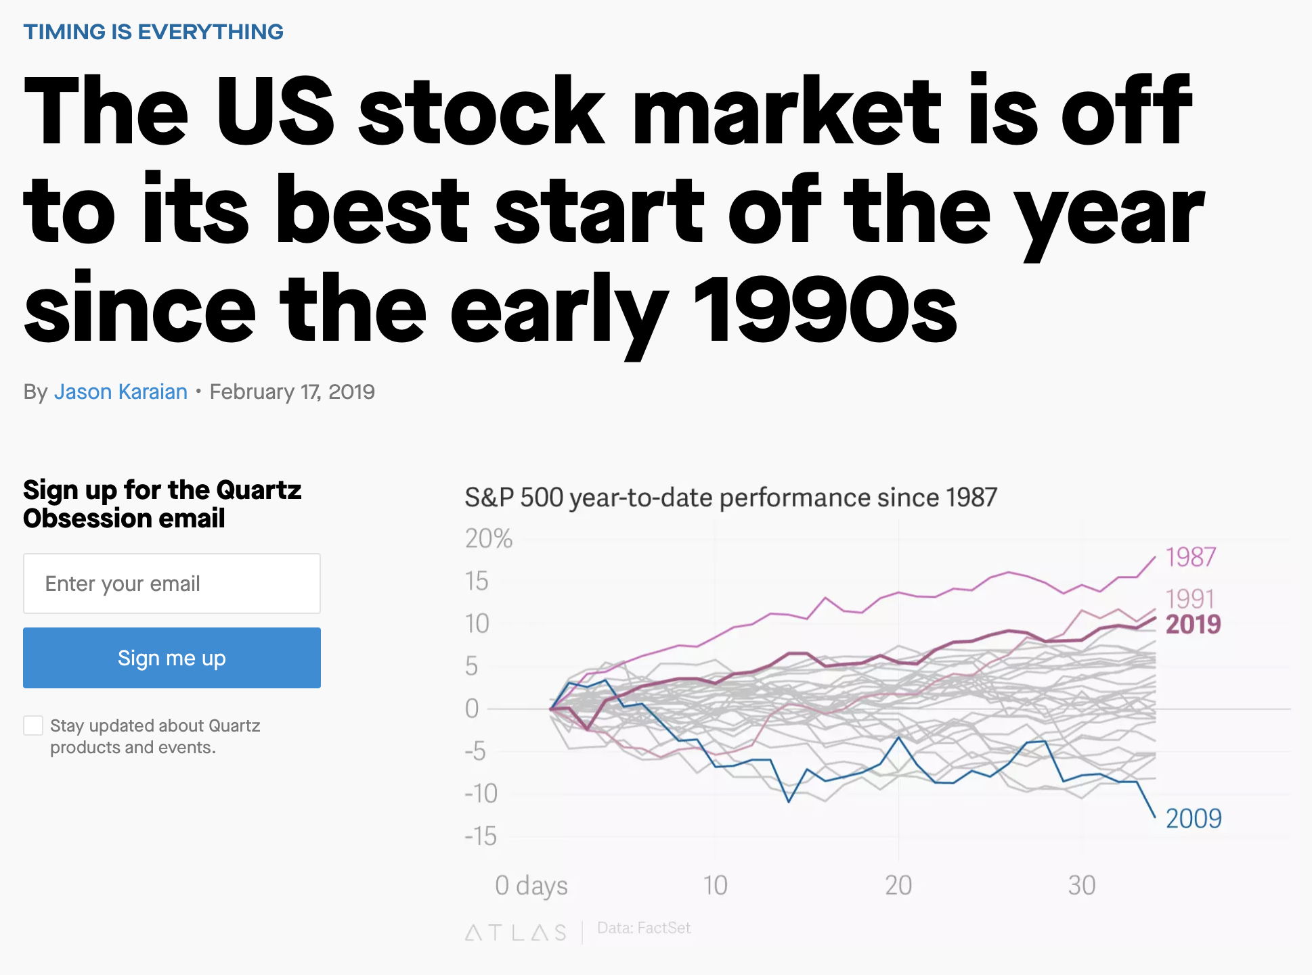

Slide 6
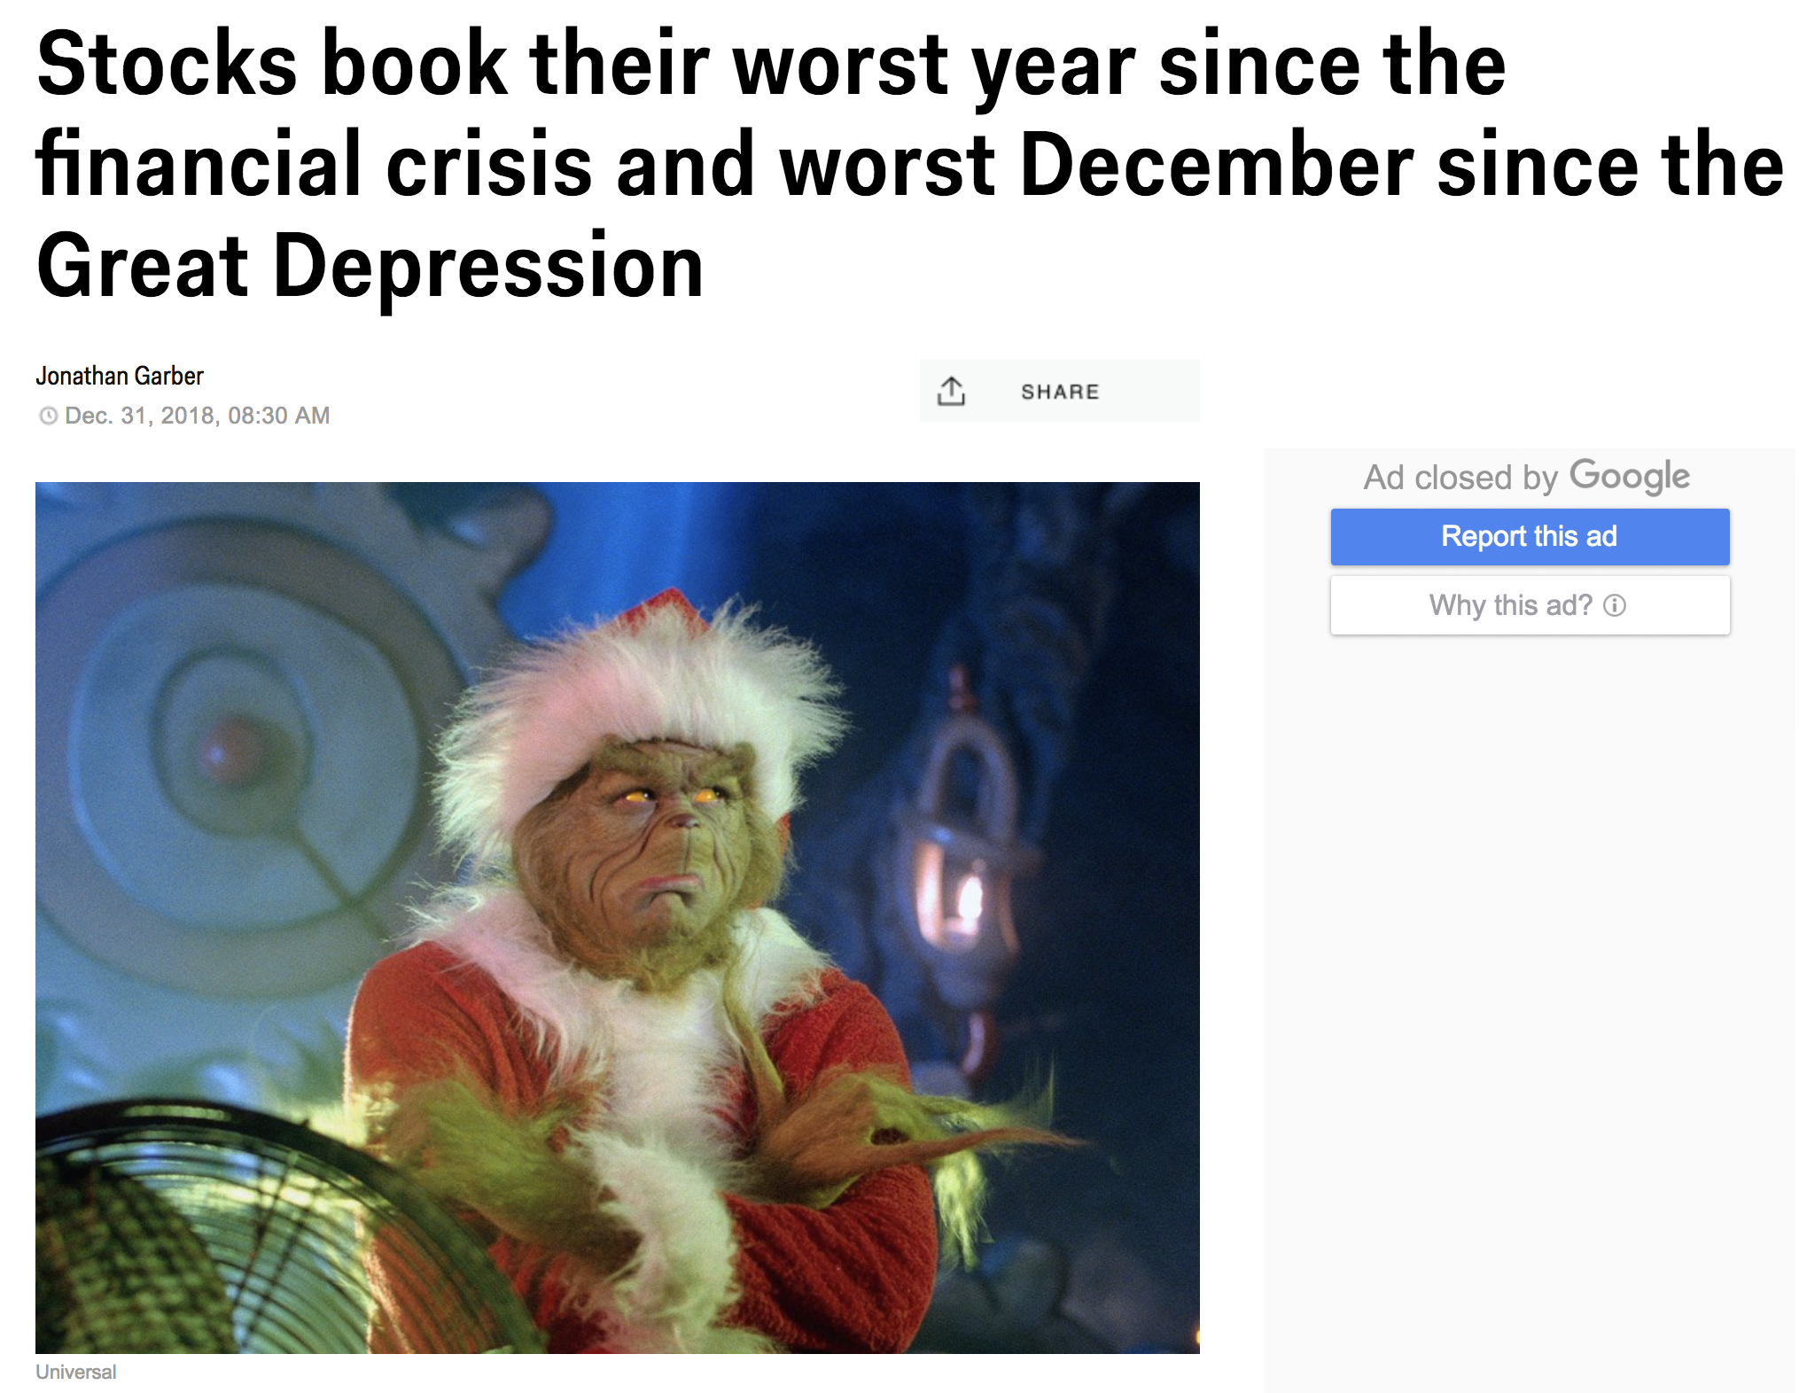

Slide 7
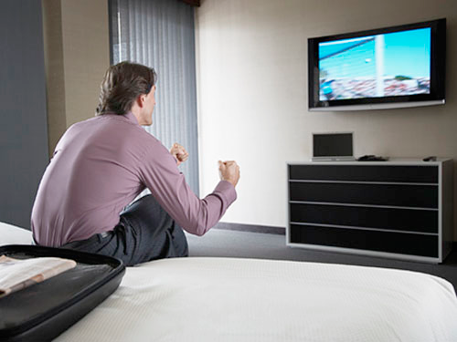
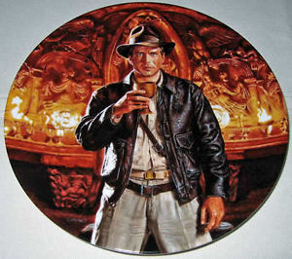
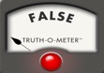

The Holy Grail: Automated, Live Fact-Checking
Source: Bill Adair

Slide 8

Claim Spotter
8

Slide 9
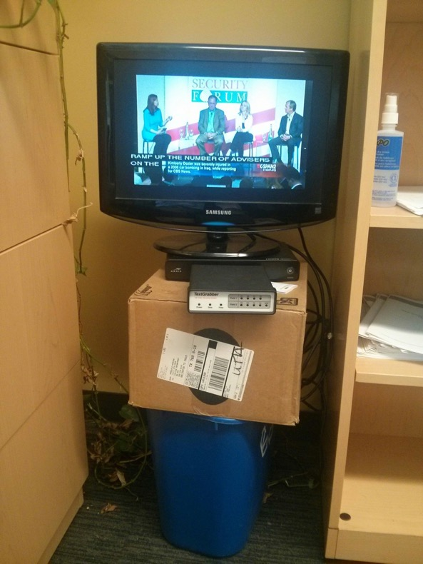
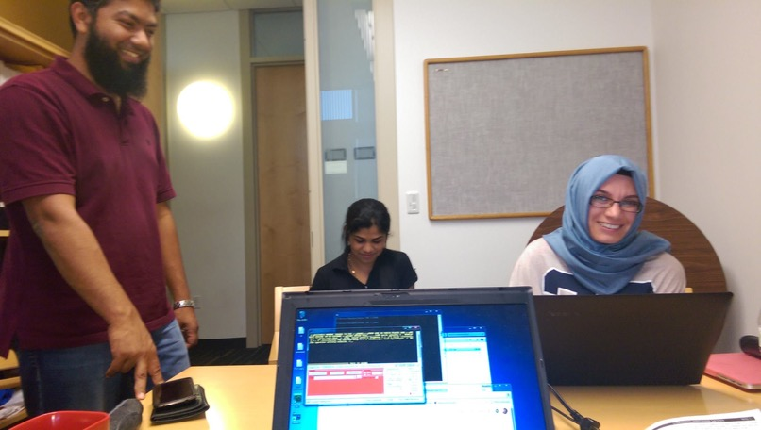

Slide 10
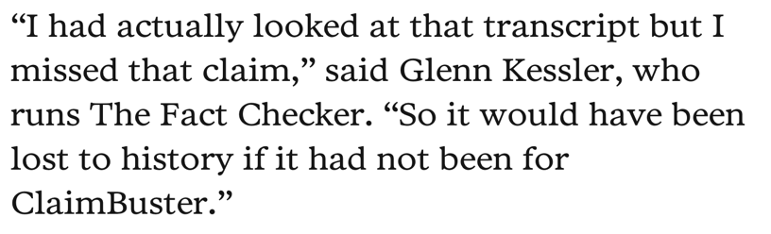
Duke Reporters’ Lab uses ClaimBuster API in creating daily newsletters that recommend to The Washington Post, New York Times, PolitiFact, and other fact-checkers the most check-worthy claims in CNN programs, Tweets, Facebook ports, and the Congressional Record.

Slide 11

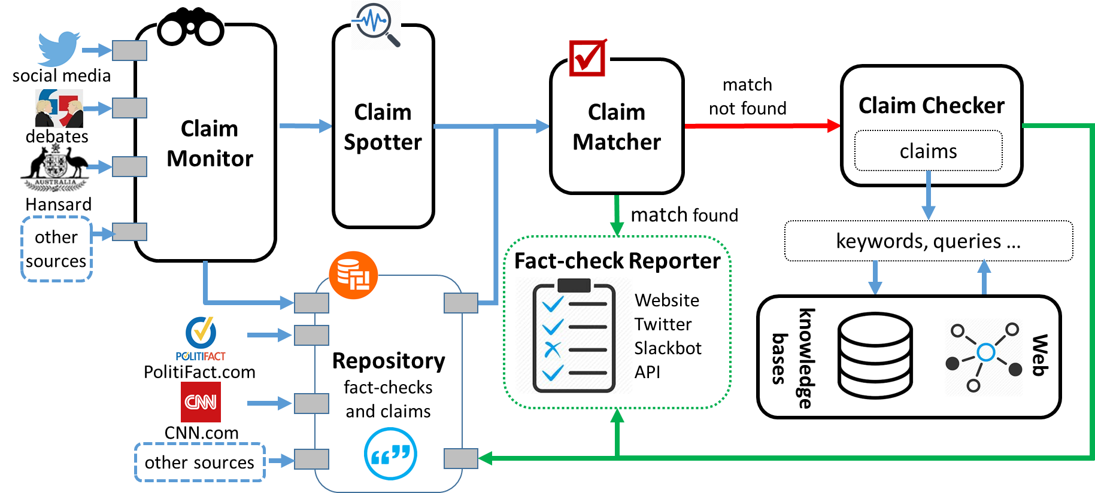
The First-ever End-to-end Fact-checking System
https://idir.uta.edu/claimbuster/
11

Slide 12
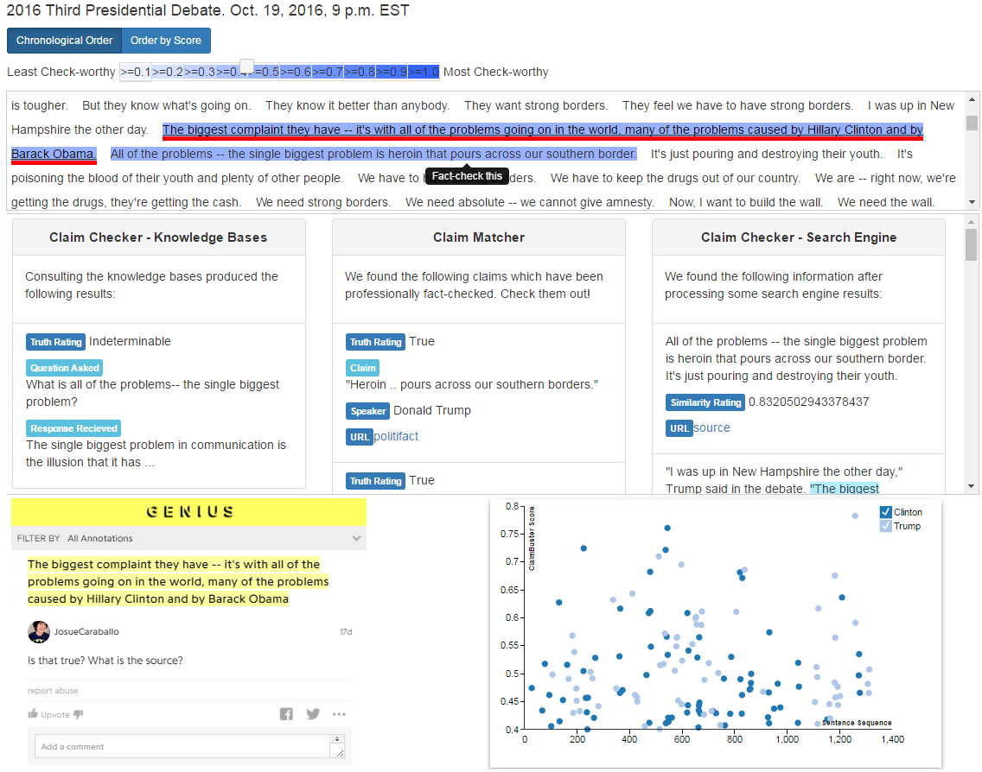
12

Slide 13
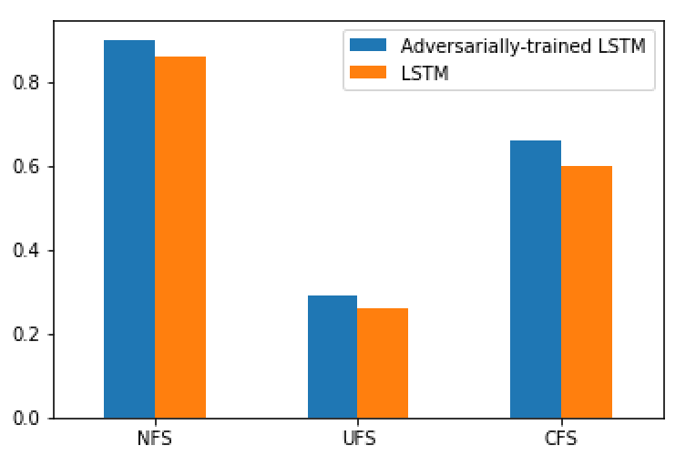
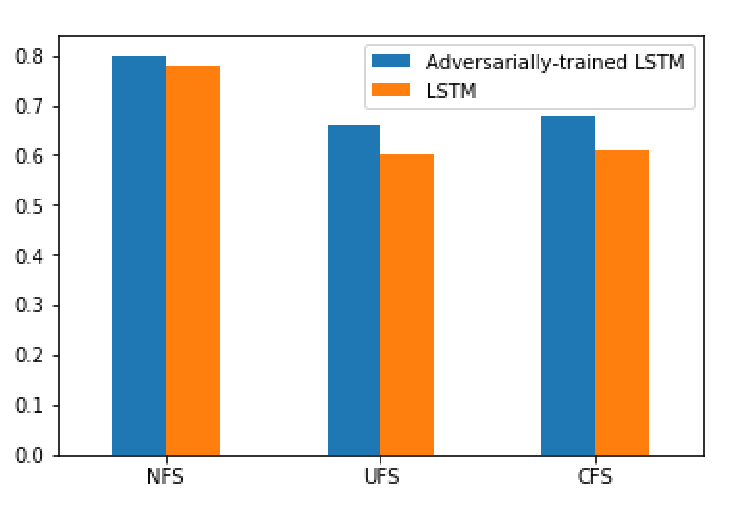
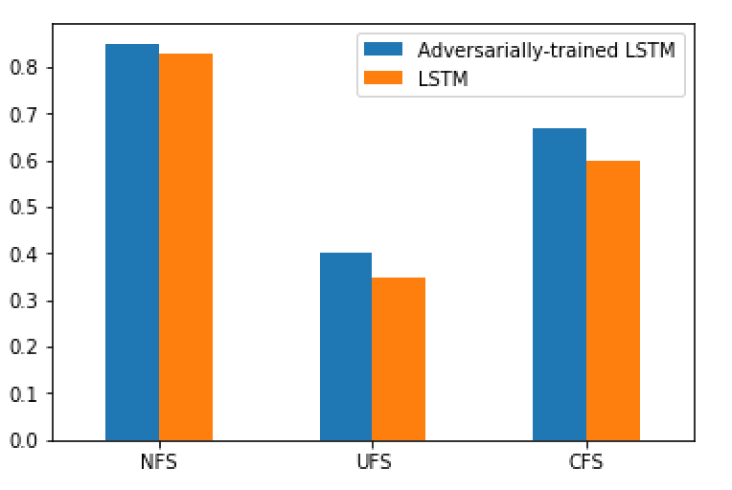
Adversarially Trained LSTM
Recall
Precision
F1-score

Slide 14
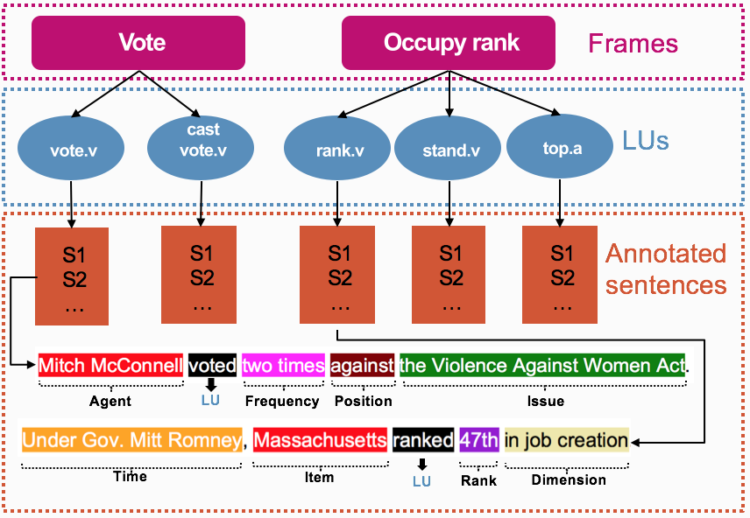
Figure: Vote and Occupy rank frames along with their LUs.
Notes:
An exemplified sentence for vote and rank Lus with color-coded frame annotations below. Labels below each sentence are frame specific frame
elements (FEs).

Slide 15
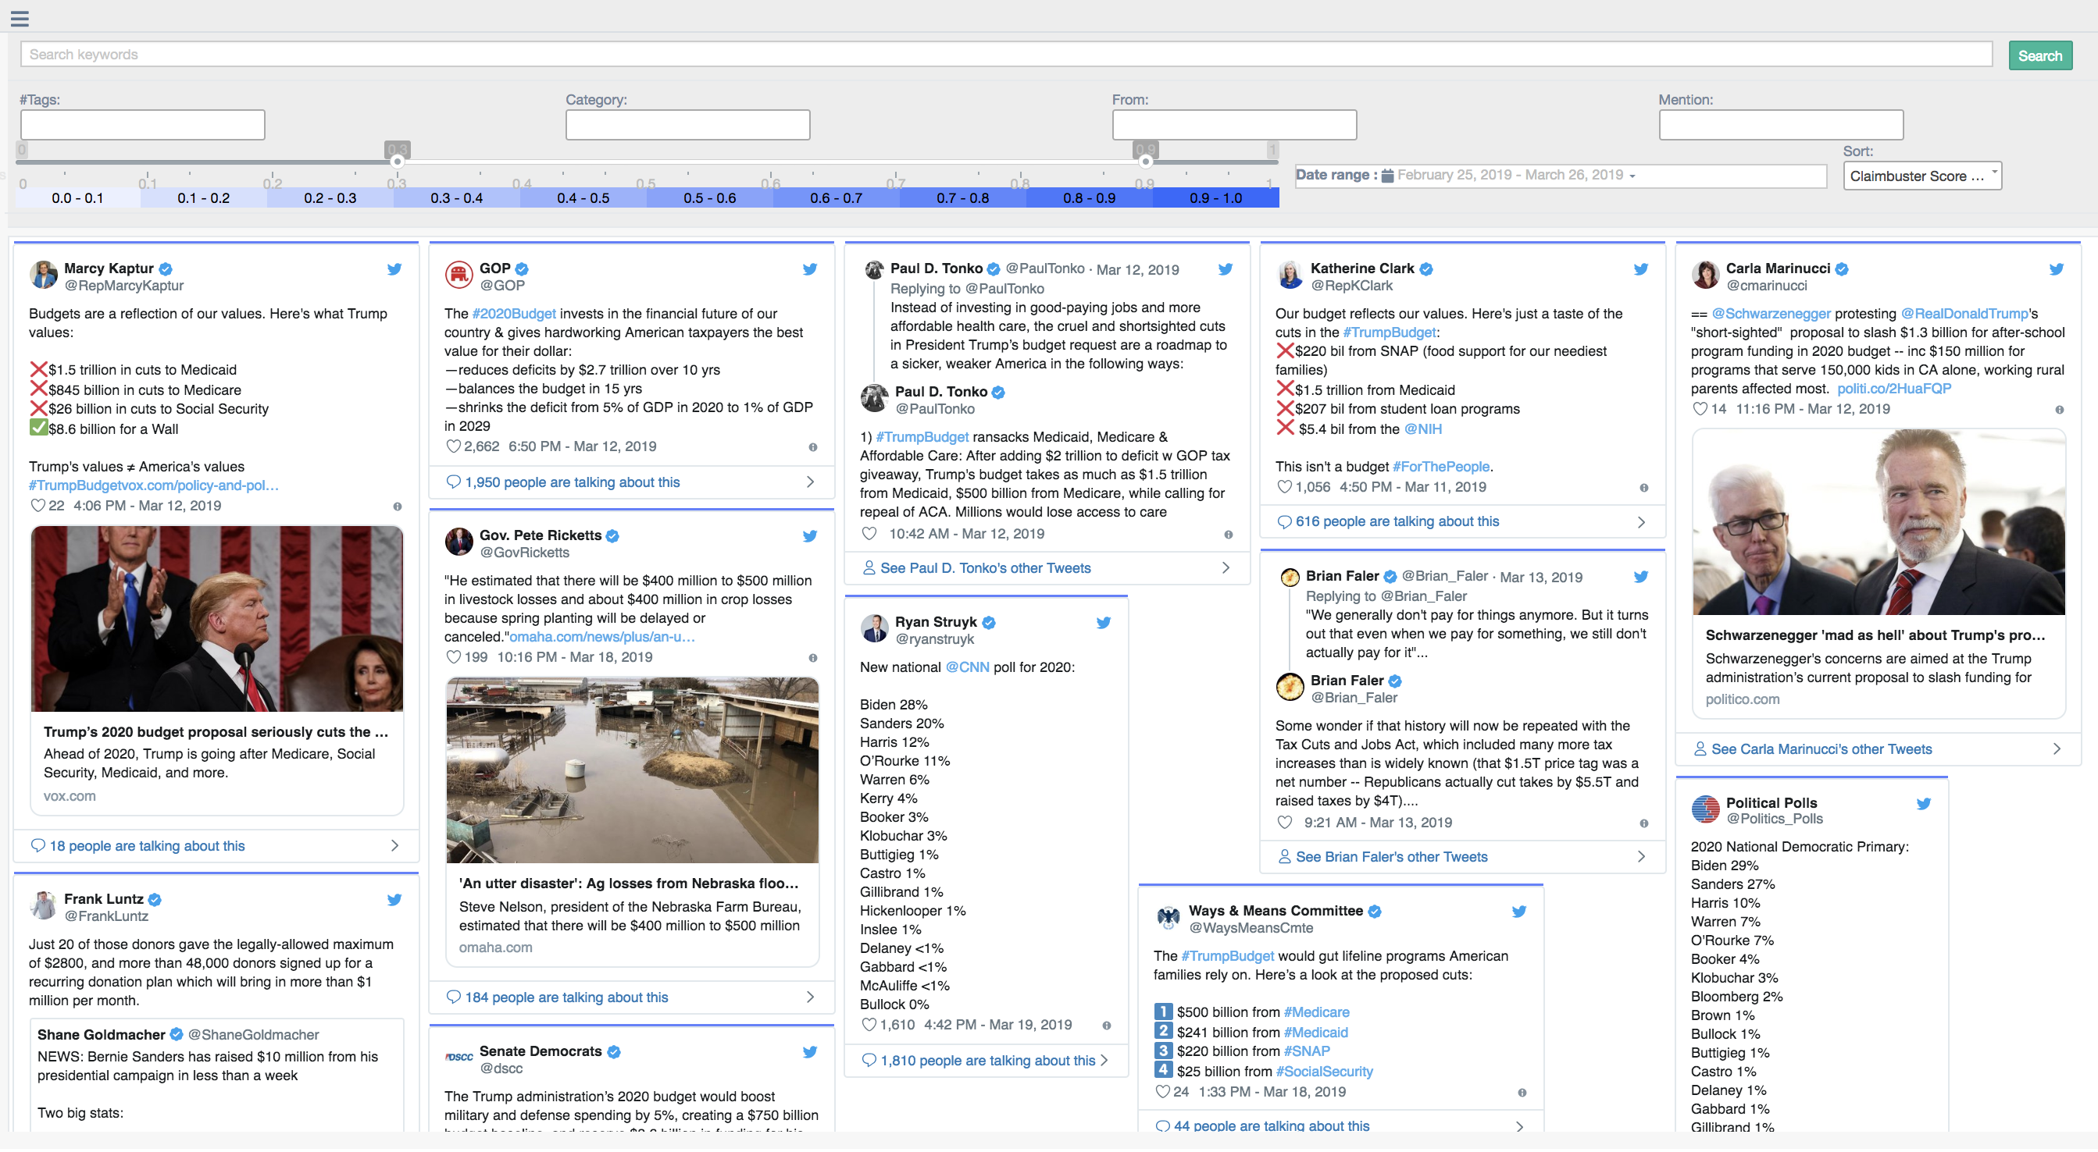
ClaimPortal: Integrated Monitoring, Searching, Checking, and Analytics of Factual Claims on Twitter
https://idir.uta.edu/claimportal/

Slide 16
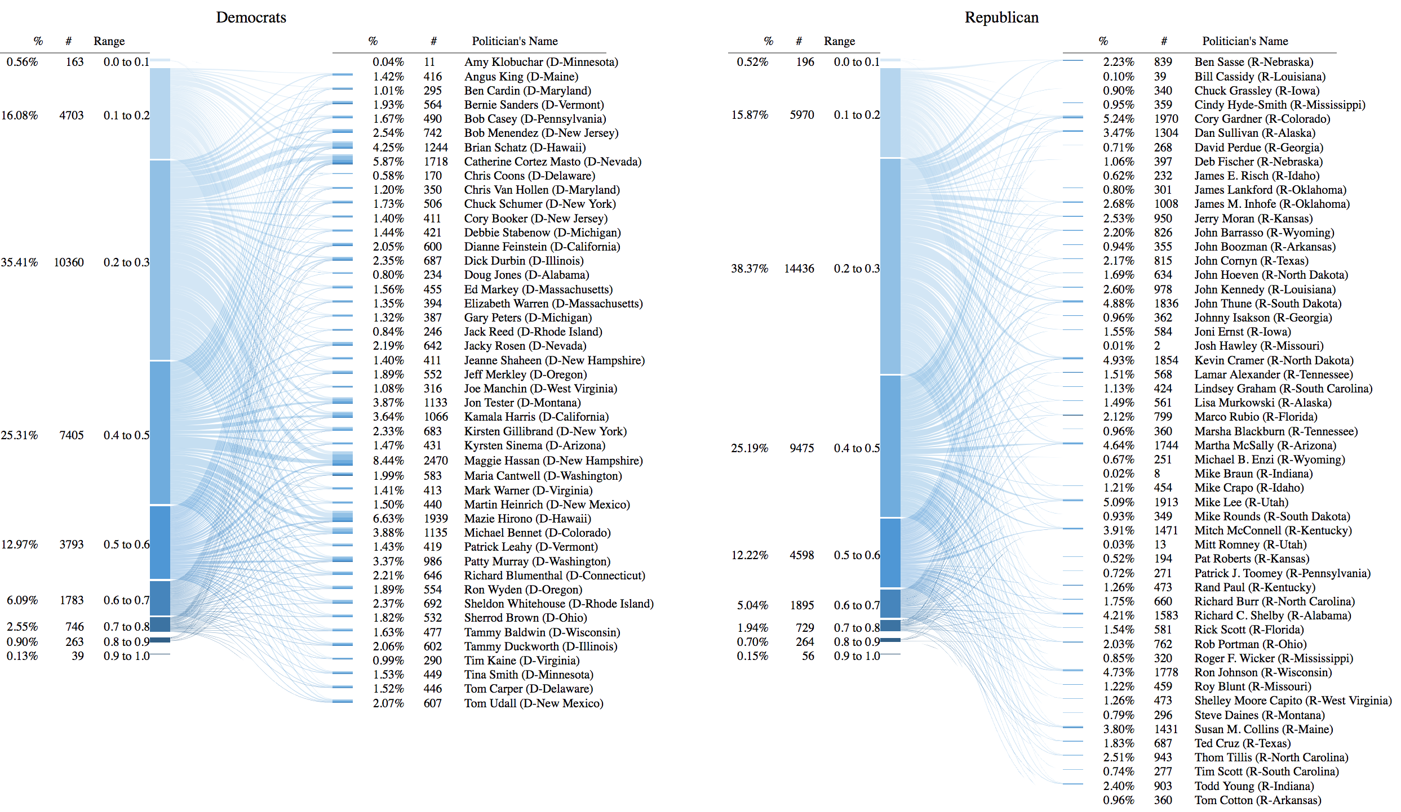

Slide 17
Where to go from here
Misinformation: a lot of challenges to tackle (fact-checking, ”fake news” websites / tweets / bots, rumors, computational propaganda, fake reviews, clickbait, “deepfake” videos, …)
Computing Research
Modeling of factual claims
Open knowledge network
Explainability of fact-finding algorithms
Interdisciplinary Research: psychology, journalism, communication, political science, …
Persuasiveness
Ethics (bias, transparency, trust, fairness)
Education, Misinformation Literacy
Community Building

Slide 18
